Slide 1

INTERNSHIP PROJECT - Developing a Machine Learning Model to predict the selling price of a used car
Name - Sakshi Bidwai | Batch - D

Slide 2
Problem Statement:
The problem that the client is facing is to accurately estimate the selling price of the used cars they deal with. It is important to provide customers with fair and reasonable prices based on the features of the car. With the help of the dataset, the client wants to develop a pricing model that can accurately predict the selling price of a used car based on its features such as the number of kilometers driven, type of fuel used, horsepower, color, transmission, engine size, number of doors, number of cylinders, number of gears, and whether it is a sport model or not.

Slide 3
My Journey in Pickl.ai:
I have been a part of Pickl.ai's learning programs for quite some time now. Previously, I had taken up a machine learning course from Pickl.ai, which ignited my interest in the Data Science field. In today's data-driven world, Data Science plays a pivotal role, driving advancements across industries, improving products and services, and enhancing overall efficiency and competitiveness. When an opportunity arose for a Data Science internship program at Pickl.ai, it was a no-brainer for me. I knew this would help me to further increase my knowledge in this field and gain valuable and practical insights.The entire training program was intensive and carefully curated, aiming to make us thorough with the required skills while providing practical hands-on sessions for each topic. The regular live sessions were a nice touch as they created a sense of involvement and helped us understand how to apply the knowledge we gained to industry-related problems.
Throughout the internship, we learned a wide range of skills, including Excel, Python Basics, Object-Oriented Programming, Statistics, Numpy, Pandas, Visualization using Python, Tableau, SQL, Data Exploration, Data Selection, Data Cleaning, and, of course, Machine Learning.

Slide 4
My Approach for the project:
The first step in developing a Machine Learning Model to predict the selling price of a used car is to gain a comprehensive understanding of the task at hand. This involves delving into the intricacies of the used car market, understanding the various factors that influence car prices, and identifying the challenges in accurately predicting the selling price.Once familiar with the domain, the next step is to obtain and explore the dataset. The dataset should consist of relevant attributes such as car make, model, year, mileage, condition, location, and historical selling prices. Performing basic Exploratory Data Analysis (EDA) is crucial to get insights into the data, understand its structure, and identify potential patterns or correlations.
During the EDA process, one may encounter missing values due to the large dataset. To address this, suitable techniques such as mean value imputation can be employed. This involves replacing missing values with the mean of the respective column to ensure the dataset remains consistent and accurate for further analysis.The target variable for our prediction model will be the selling price of the used car. Thus, it becomes essential to focus on understanding the distribution of selling prices, identifying potential outliers, and analyzing how other features correlate with the target variable.One of the most crucial aspects of the dataset is the 'selling price' column, as it plays acentral role in our prediction task. Our end goal is to develop a machine learning model that accurately predicts the selling price of a used car given its relevant features.Depending on the nature of the data and the target variable (continuous or categorical),appropriate machine learning algorithms like regression or classification models can be considered.

Slide 5
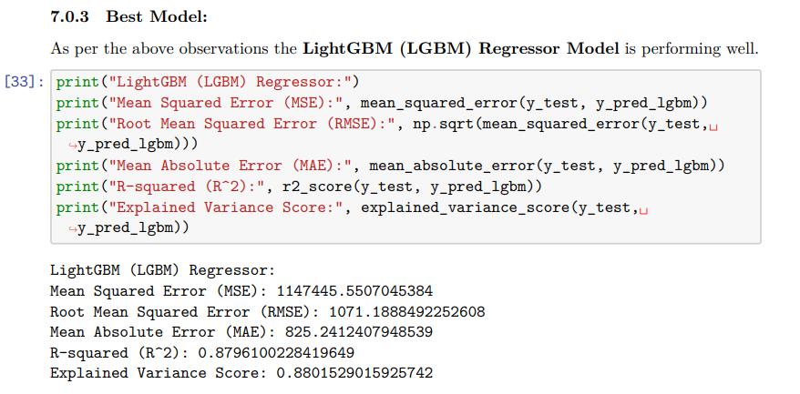
Best Model for selling price prediction

Slide 6
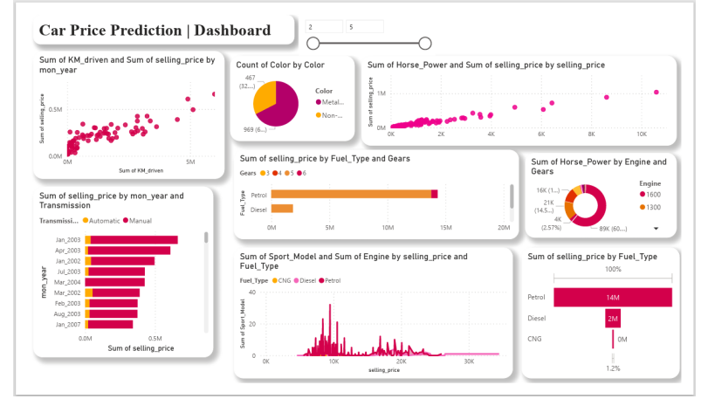
Dashboard

Slide 7
Conclusion
In summary, developing a Machine Learning Model to predict the selling price of a used car requires a systematic approach that includes understanding the problem, exploring the dataset, handling missing values, conducting EDA, selecting appropriate features, and preparing the data for model training. By following these steps diligently, we can build an accurate and reliable prediction model that will revolutionize the way used cars are priced and traded in the automotive market.

